Slide 1
Cooking Merit Badge
Troop 227
Sept 2015

Slide 2
Plan of Action
Week 1 –
Food Safety and Food Preparation
Meal Planning
Food Labels
Types of cooking
Homework from Week 1
Req 6a & b
Make weekend menu for patrol (5 meals plus one desert or snack)
Prepare shopping list for the 5 meals
Week 2 – Cooking!
Dutch Oven, Foil pack or kabobs, or pan
1 breakfast, 1 lunch, 1 dinner, one dessert or snack
Cleanup
Homework from Week 2
Req 7a and b
Make weekend menu for patrol for backpacking trip (3 meals, plus one snack)
Week 3 – Cooking!
Backpack/ Trail food meal
2 typical meals and a snack
Cleanup
Homework for Week 3
Req 8

Slide 3
Cooking Hazards
What can go wrong when you cook?
Bad food
Food Poisoning
Spoiled Food
How do you prevent this?
What is First Aid for this?
Allergies
Common allergies: Nuts, eggs, dairy
Many others – depends upon the person, if any
How do you prevent this?
What is First Aid for this?
Injuries
Burns, cuts, scalds, choking
How do you prevent this?
What is First Aid for this?

Slide 4
Food Storage
How should we store fresh foods? How do we prepare it properly for cooking?
Meat?
Fish?
Chicken? Eggs?
Dairy products?
Fresh Vegetables?
What is “cross-contamination”?
How do we prevent it?

Slide 5
Food Related Illnesses How do we prevent these?
Salmonella
Raw and undercooked foods
Diarrhea, Fever abdominal cramps, for up to a week
Staphylococcal aureus
Grows very quickly in improperly stored foods or improperly cooked foods
Nausea, vomiting, stomach cramps diarrhea for up to several days
Escherichia coli (E. coli)
Spread through human or animal waste and incompletely cooked foods
Abdominal cramps, diarrhea, vomiting and low fever for 5-7 days.
Clostridium botulinum (Botulism)
Improperly canned or stored foods
Nerve toxin, with double vision, slurred speech, drooping eyelids, muscle weakness, difficulty swallowing or breathing for up to 10 days after eating. Can be deadly
Campylobacter jejuni
Bacterium from contaminated water, raw/ unpasteurized milk, or raw or undercooked meat
Diarrhea, abdominal pain, nausea, headaches, and fever for 5-7 days starting 2-5 after eating

Slide 6
Food Related Illnesses How do we prevent these?
Hepatitis A
Improper handing of food, consumption of contaminated food or water, or human-to human contact
Fever, nausea, abdominal discomfort and jaundice -- up to several weeks
Listeria monocytogenes
Contaminated foods, such as unpasteurized milk or raw foods
Fever, nausea, muscle aches, diarrhea – can spread to the nervous system and get much worse
Cryptosporidium
Parasite spread through untreated water and contaminated food
Dehydration, stomach cramps, fever, nausea, vomiting and weight loss for up to weeks after you get it.
Norovirus
Human waste and Contaminated surfaces to go from person to person
Diaherra, vomiting, abdominal pain – can be deadly if goes into dehydration
Other --
Food allergies, food intolerance, other food-related diseases,

Slide 7
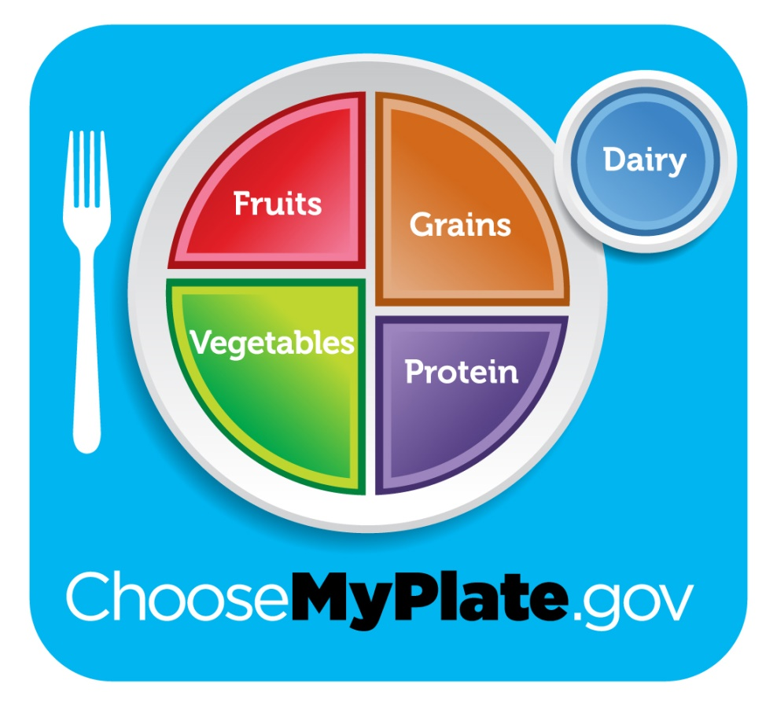
Food Planning
Name 5 of each
Fruits
1.5 – 2 cups a day
Vegetables
2.5 – 3 cups a day
Grains
6 – 8 oz per day
Proteins
5 – 6.6 oz per day
Dairy
3 cups per day
www.choosemyplate.gov

Slide 8
Think about it..
Do you eat a balanced diet?
What are you current eating habits?
Why should you limit your intake of oils and sugars?
How does exercise and activities effect your need for food and nutrition?

Slide 9
Key Terms
Calorie - A unit of food energy.
Fat - A type of food. Needed for proper function of your body. But people eat too much of the wrong types of fat
Saturated fat - A type of fat, found in animal fats (cream, cheese, butter, lard, etc) and in some vegetable oils (coconut oil, palm oil). Can increase risk of heart disease
Trans fat - A type of fat, not normally found in nature that is produced from vegetable fats for use in prepared foods such as fast foods. Strong evidence with heart disease
Cholesterol - A natural substance needed for your body to function. But if it goes out of balance, it can lead to heart disease, heart attacks and strokes. Affected by what type of foods you eat.
Sodium - Chemical needed in your body, from salt “sodium chloride”. Can easily get too much from common food use.
Carbohydrate - One of the main types of nutrients. They are the most important source of energy for your body.
Dietary fiber - “Roughage” is the indigestible portion of food derived from plants.
Sugar - Common name for sweet tasting soluble carbohydrates, many of which are used in food. Very high in energy.
Protein - Proteins are large biomolecules, or macromolecules, consisting of one or more long chains of amino acids. You need protein in your diet to help your body repair cells and make new ones. Protein is also important for growth and development

Slide 10
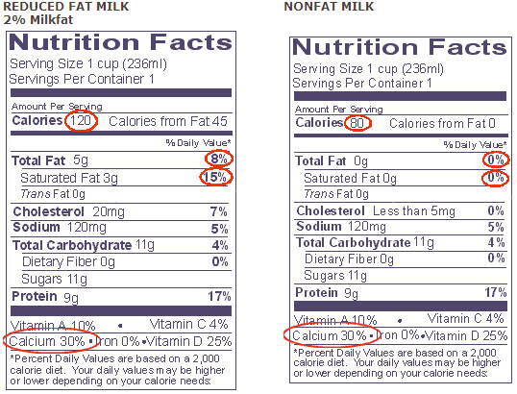
Food Labels!

Slide 11
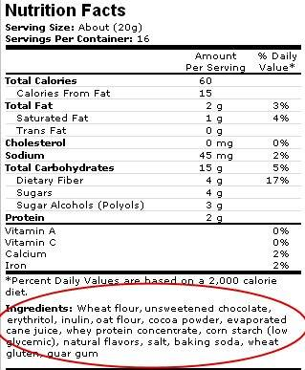
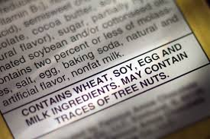

Food Labels!

Slide 12
Types of cooking
Types of Cooking
Discuss the benefits of using a camp stove on an outing vs. a charcoal or wood fire.
How does the Outdoor Code and no-trace principles pertain to cooking in the outdoors
Type of cooking | Equipment Needed | Typical Food
Baking
Boiling
Pan Frying
Simmering
Microwaving
Grilling

Slide 13
Homework for Week 2
Any requirements not met in Week 1
Requirement 6a& b
Make weekend menu for patrol (5 meals plus one desert or snack)
Prepare shopping list for the 5 meals
Hint: Think about your food groups and a balanced diet while making up the menus
BRING MENUS & SHOPPING LISTS TO MEETING NEXT WEEK to get the requirement credit
Fill out your worksheet from this week

